Slide 1


Slide 2
SQL Introduction
History and the SELECT statement

Slide 3

SQL History
Recall, developed by IBM
Donald Chamberlin & Raymond Boyce
Originally called SEQUEL but changed to SQL due to trademark issues
Notes:
Can be found online… but I can’t link to it

Slide 4

SQL History
Initially every vendor had its own variant of SQL
Oracle SQL was not compatible with DB/2 SQL
This is still true to an extent
MySQL & Postgresql have different features and flavors
Case sensitivity is a big one!
MySQL - not case sensitive
Notes:
Can be found online… but I can’t link to it

Slide 5
SQL History
Standardization efforts
SQL86, SQL89...SQL2016
SQL99 is a popular standard
Standardized majority of the SQL language
Was heavily referred to during the dotCom era
MySQL kinda sorta implemented it
Notes:
Can be found online… but I can’t link to it

Slide 6
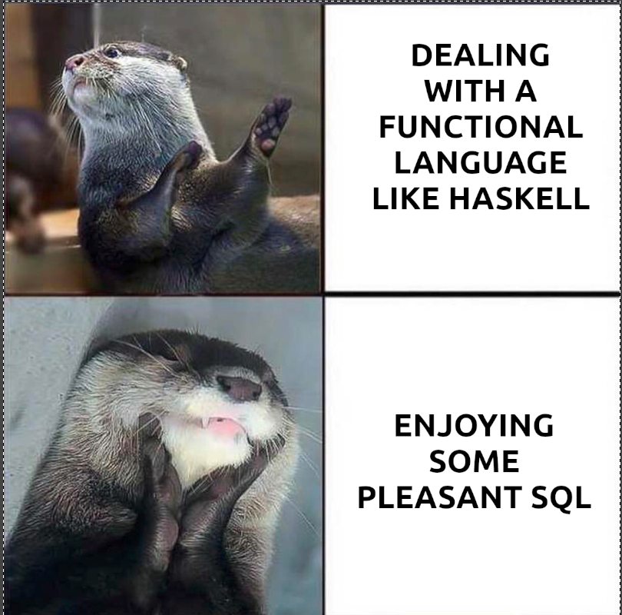
SQL As A Language
SQL is a declarative programming language
You tell the computer what you want, not how to get it
It’s a functional language!
Perhaps the most successful functional language in history
Eat it, Haskell nerds
Notes:
Can be found online… but I can’t link to it

Slide 7
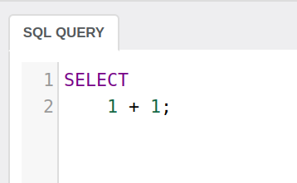
SQL As A Language
SQL consists of a variety of statements
Today we will be talking about the SELECT statement
As you might suspect, a select statement starts with the word SELECT
Notes:
Can be found online… but I can’t link to it

Slide 8
SQL As A Language
SQL is NOT case sensitive
However, there are case conventions
Key words are all caps
Tables are often capitalized
Columns are usually lower case
Sometimes camel case, sometimes underscore separated
Notes:
Can be found online… but I can’t link to it

Slide 9
SQL - Select
The SELECT statement is the most complex statement in SQL
As you can see to the right, mathematical statements are possible
The result of this select statement is the value 2
Earth shattering, I know
Notes:
Can be found online… but I can’t link to it

Slide 10
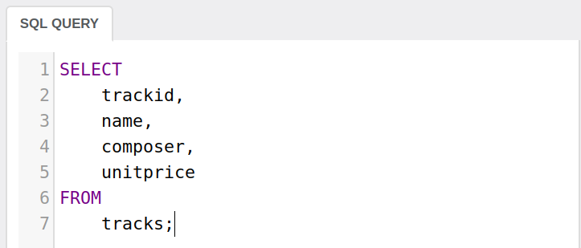
SQL - Select
That’s not very interesting, let’s actually select some data from our database
Here you see selecting specific columns FROM a specific table
Returns these column values for all rows
Notes:
Can be found online… but I can’t link to it

Slide 11
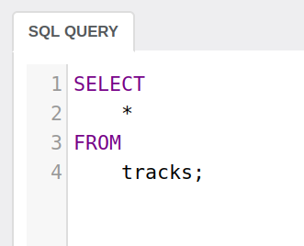
SQL - Select
Perhaps you want to select all values from a row
You can use the asterisk operator to return all columns
Pros
Shorter
Easier to get right
Cons
Might bring back unused data
Unclear what columns are available
Notes:
Can be found online… but I can’t link to it

Slide 12
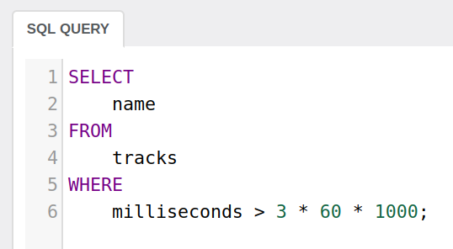
SQL - Where
Typically not useful to bring back all the data of a table
You often want to find a particular piece of data
Enter the WHERE clause
Notes:
Can be found online… but I can’t link to it

Slide 13
SQL - Where
The WHERE clause allows you to give predicates that a row must satisfy in order to be included in the results
Show me the name of all tracks that are longer than 3 minutes
Notes:
Can be found online… but I can’t link to it

Slide 14
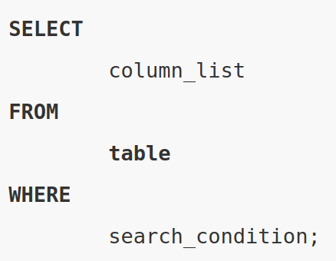
SQL - Select
This is the general form of SELECT
Simple, but powerful
Notes:
Can be found online… but I can’t link to it

Slide 15
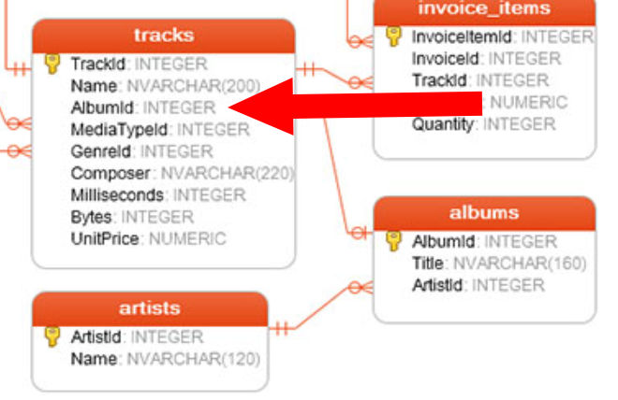
SQL - Where
Recall foriegn keys
There is a 1-N relationship between albums and tracks
The tracks table has an AlbumId column
We can use this column in a WHERE
Notes:
Can be found online… but I can’t link to it

Slide 16
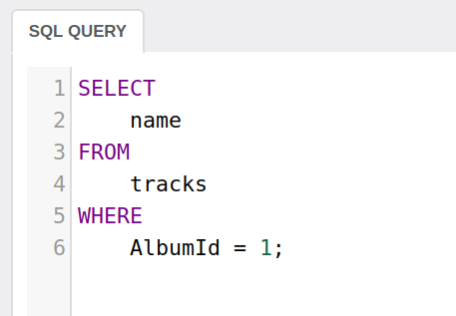
SQL - Where
Give me the name all the tracks on the album with the AlbumID of 1
Note that the = operator is a single character!
Notes:
Can be found online… but I can’t link to it

Slide 17
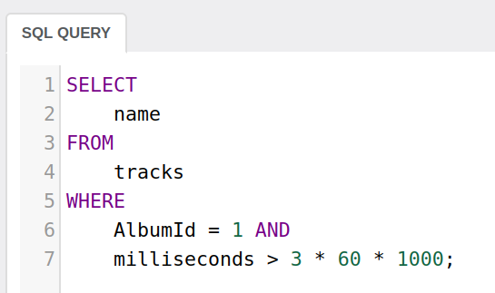
SQL - Combining Predicates
You can combine predicates using the AND and OR expressions
Give me the name all the tracks on the album with the AlbumID of 1 that are also longer than 3 minutes
Notes:
Can be found online… but I can’t link to it

Slide 18
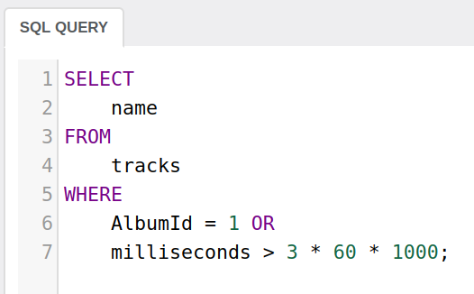
SQL - Combining Predicates
Give me the name all the tracks on the album with the AlbumID of 1 OR that are longer than 3 minutes
Notes:
Can be found online… but I can’t link to it

Slide 19
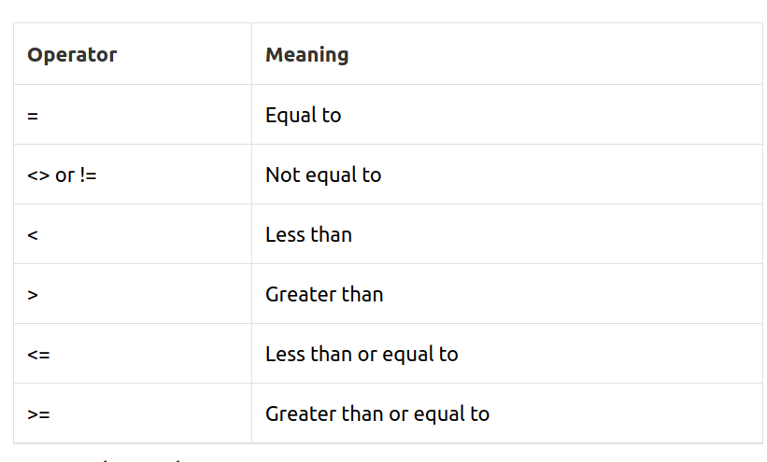
SQL - Comparison Operators
Most operators will be familiar to you from other programming languages
The major exceptions:
equals (a single = character)
double equals usually works too
not equals (<>)
Notes:
Can be found online… but I can’t link to it

Slide 20
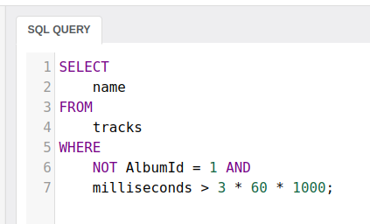
SQL - Logical Operators
We have seen AND and OR
There is also NOT
What does this query mean?
Notes:
Can be found online… but I can’t link to it

Slide 21
SQL - Logical Operators
Careful with binding!
Return the name of all tracks not on album 1 and that are longer than 3 minutes
Notes:
Can be found online… but I can’t link to it

Slide 22
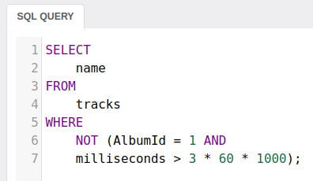
SQL - Logical Operators
Use parentheses to get the right expression
Return the name of all tracks not on album 1 and that are not longer than 3 minutes
Notes:
Can be found online… but I can’t link to it

Slide 23
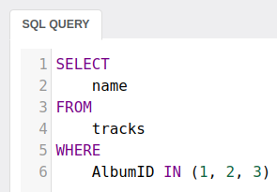
SQL - Logical Operators
The IN operator is extremely useful
All rows where attribute value falls into a subset
Can be used with what is called a SubSelect for advanced queries (covered later)
Notes:
Can be found online… but I can’t link to it

Slide 24
SQL - Logical Operators
The IN operator is extremely useful
All rows where attribute value falls into a subset
Can be used with what is called a SubSelect for advanced queries (covered later)
Notes:
Can be found online… but I can’t link to it

Slide 25
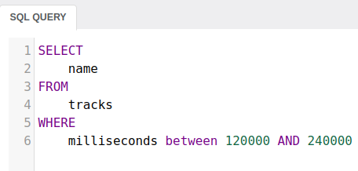
SQL - Logical Operators
The BETWEEN operator less widely used
Can be replaced with two comparison expressions
Might be clearer in some cases
Give me the name of all tracks between 2 and 4 minutes long
Notes:
Can be found online… but I can’t link to it

Slide 26
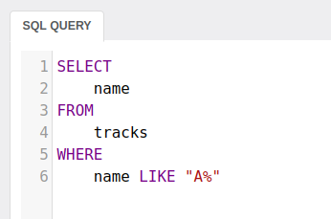
SQL - Logical Operators
The LIKE operator can be used for string matching
Incredibly useful
Percent (%) is a wildcard
Give me the name of all tracks that start with a capital A
Notes:
Can be found online… but I can’t link to it

Slide 27
SQL - Logical Operators
Incredibly useful…
Also incredibly expensive
Difficult to index for in the general cases
Google doesn’t use relational databases for search, for a good reason
Still, if you don’t have google-size data, it’s great!
Notes:
Can be found online… but I can’t link to it

Slide 28
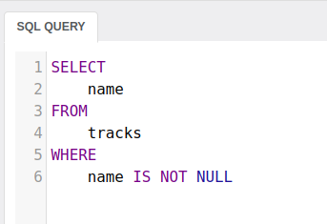
SQL - Logical Operators
NULL checks:
IS NULL
IS NOT NULL
What does NULL mean?
Notes:
Can be found online… but I can’t link to it

Slide 29
SQL - The Select Statement
That’s a lot of stuff, but it’s not too bad I hope
But you have probably learned about 30% of what you need to be a useful employee in most tech firms
Next lecture we will discuss sub-queries, which expand on this basic knowledge
Play around with the IntelliJ
You can’t hurt the database with a select
Except performance ;)

